Slide 1
Project Number: 2020-01-066
Drone Search and Rescue:
Finding People and Handing Over Supplies
Team: Barak Loebenstein, Asaf Havia
Academic Advisor: Dr. Jessica Cauchard

Slide 2
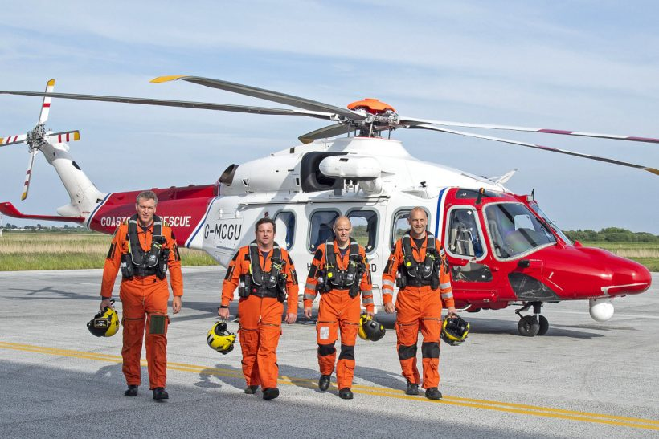
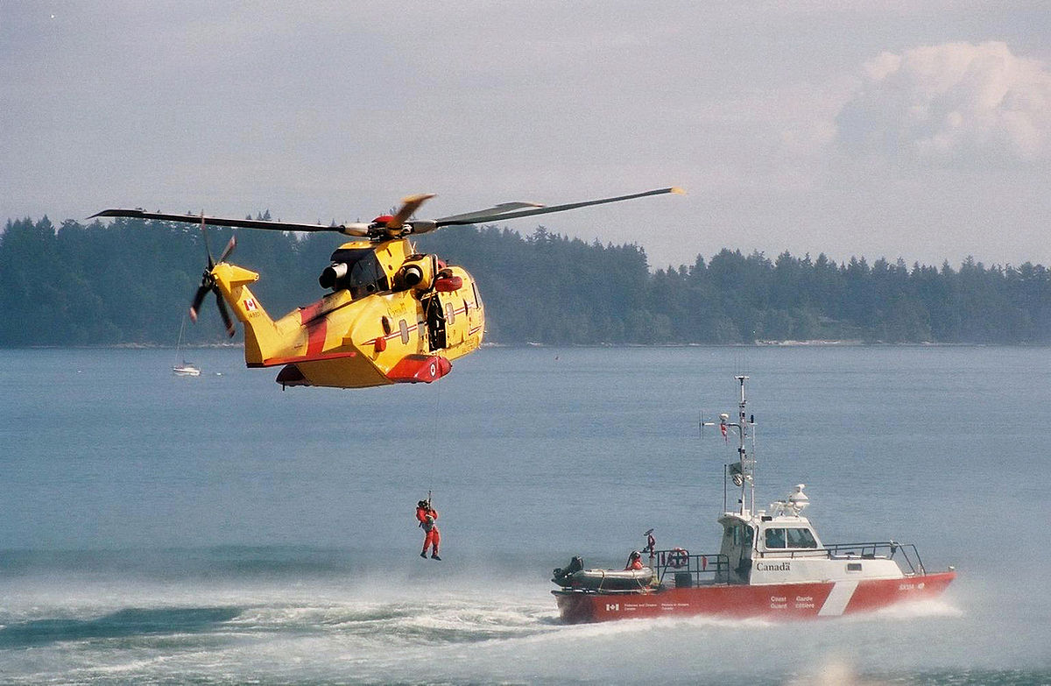
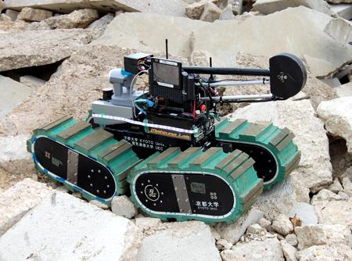
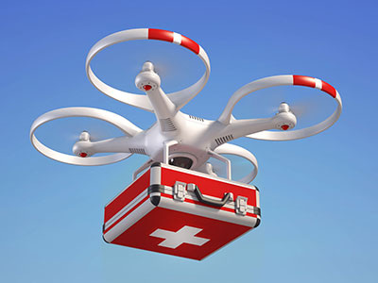
Search and Rescue

Slide 3
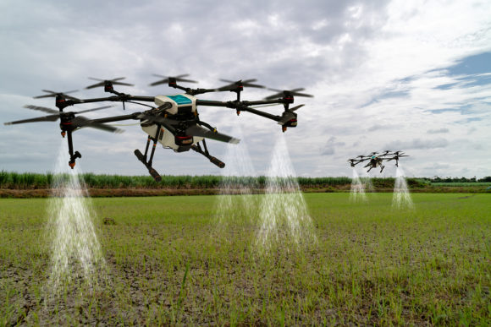
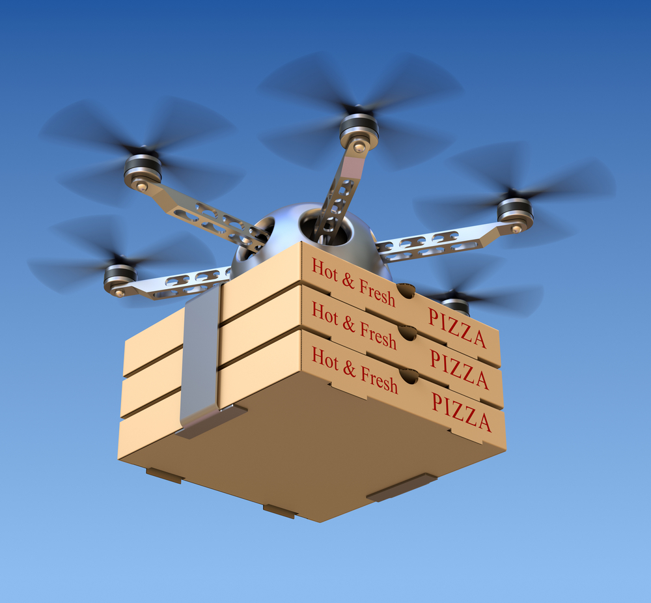
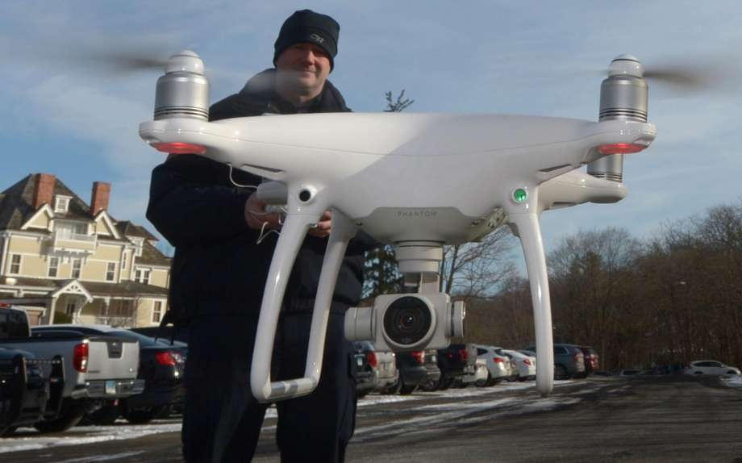
DRONES
USES IN THE MARKET
The field is evolving rapidly
Improvements in hardware and software
Various Industry and Personal uses

Slide 4
DRONES
ADVANTAGES
#
Speed
#
Mobility
#
Affordability
#
Scalability

Slide 5
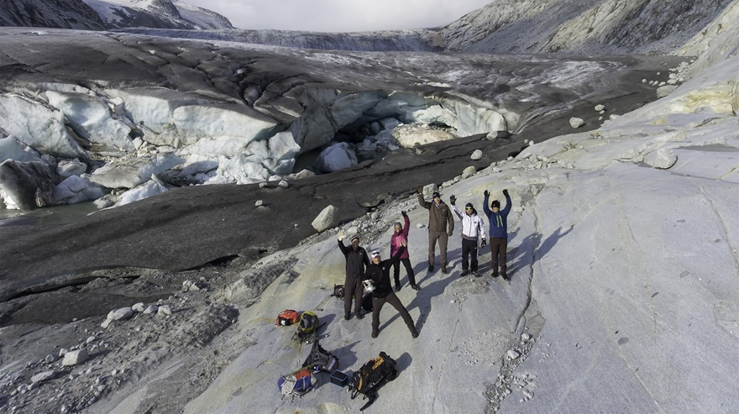
Conducted by DJI, the European Emergency Number Association, and Black Channel
“A new study on the effectiveness of drones in finding lost individuals demonstrates drones can be an excellent tool”

Slide 6

Our Project’s Goal:
Create a Human-Drone Interaction

Slide 7


Handover Interaction Device
Short Learning Time
Easy To Program
Modular
Changeable Device

Slide 8

Work Plan
Drone’s Flight
Parameters
Scanning
Face Detection
Tracking
Flying Speed
Release Height
Distance from the person
Communication Interface
Deliver a Device
Tethered
Landing
Design an Interface
Language options

Slide 9
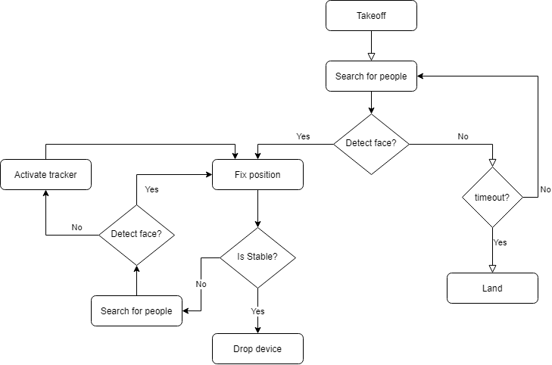
Algorithm
* DJI Tello , Python 3, Windows
Scanning
Waiting for consistent faces
Face Detection
OpenCV package
Tracking
Front Tracking
Identification
Waiting for steadiness

Slide 10
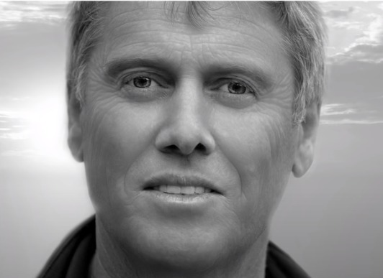
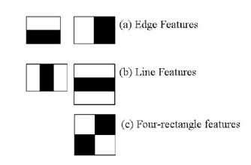
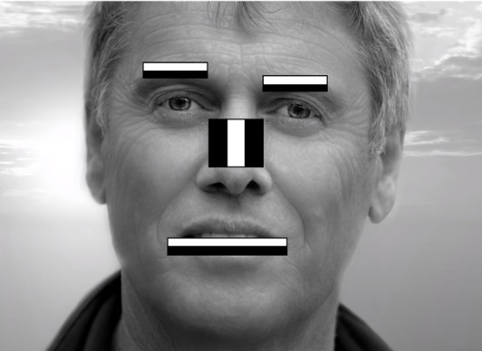
Face Detection - opencv
* Haar Cascade

Slide 11
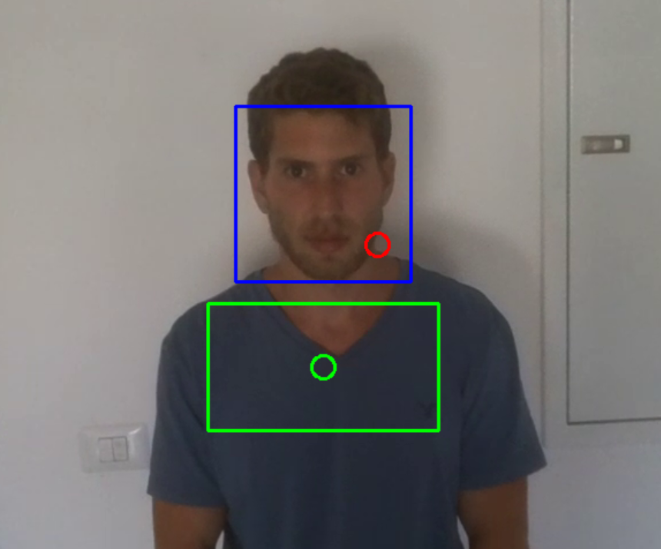
Tracking

Slide 12
Tracking
Offset Box
Jitter

Slide 13
Tracking
0
1
2
3
4
5
Offset Box
Face size: 2
Jitter
Z
Calculate Differences
Target Vector – X , Y , Z
Y
X

Slide 14
Tracking
0
1
2
3
4
5
Offset Box
Face size: 2
Jitter
Calculate Differences
Target Vector – X , Y , Z
Correcting
Movement – ( 0 , -S , -S)

Slide 15
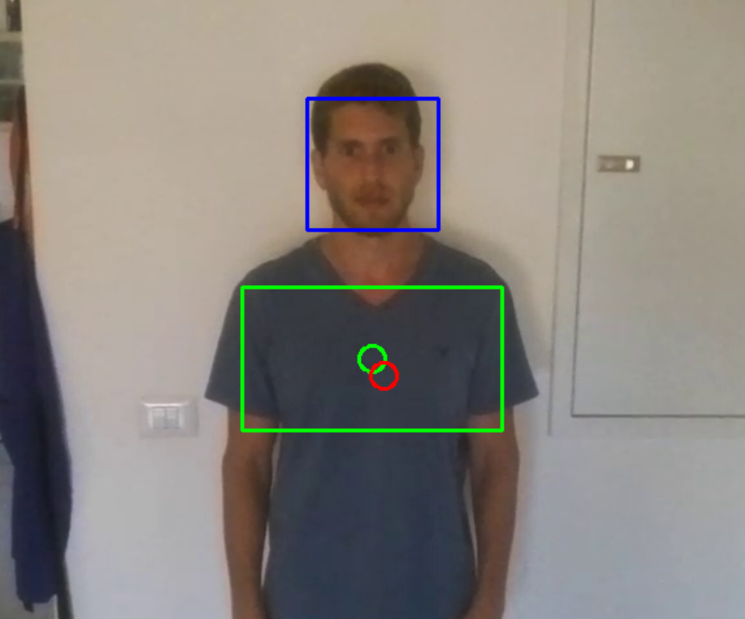
Tracking
0
1
2
3
4
5
Offset Box
Face size: 3
Jitter
Calculate Differences
Target Vector – X , Y , Z
Correcting
Movement – ( 0 , -S , -S)
StableObject
Detection rate over a number of consecutive frames

Slide 16
Tracking
Offset Box
Jitter
Calculate Differences
Target Vector – X , Y , Z
Correcting
Movement – ( 0 , -S , -S)
StableObject
Detection rate over a number of consecutive frames
Handover Device
Simulated by landing on the palm

Slide 17
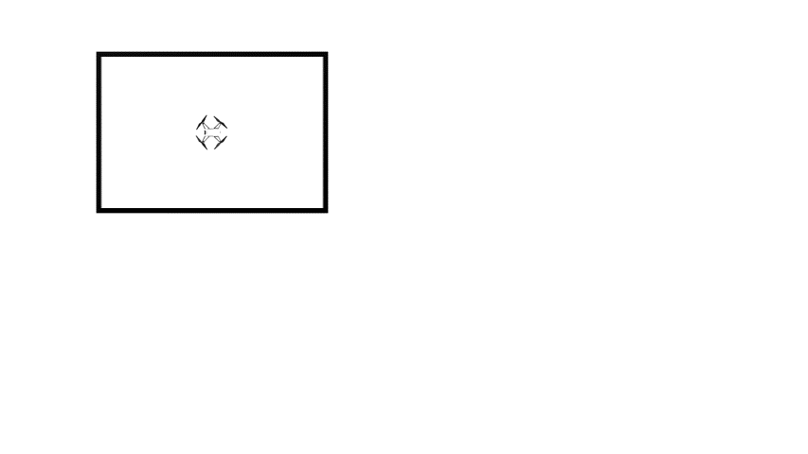
Parameters Tuning
Scanning
Number of consecutive frames
Notes:
In this part I'm going to explain how we got the parameters we defined earlier
In the scanning part we found out that sometime the drone false detect a face what cuese him to stop at the wrong place
We demand consecutive number of positive identifications, we execute a test as shown in the slide where we ran the scanning part when there is no person in the area and checked if the drone can complete a full round

Slide 18
Parameters Tuning
Scanning
Number of consecutive frames
Notes:
We performed 10 tries for each number of consecutive frames. When the numbers of frames were too low, the drone would falsely detect faces and stop to scan in the wrong place. 4 consecutive frames had shown the best result for the minimum requirement and we chose to use this parameter.

Slide 19
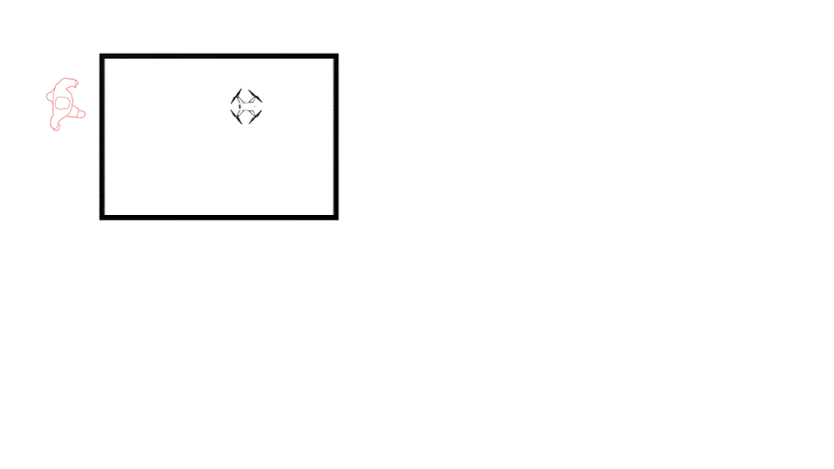
Parameters Tuning
Scanning
Number of consecutive frames
Tracking Distance
Number of consecutive frames
Notes:
We wanted to check the best distance for best tracking, when the drone is too close to a person it tends to lose track of the person, when the drone is too far from a person it tends to get many noises and false detections.
We did the same routine in the same speed as shown for moving in front of the drone and counted the number of times the drone lose track
we define success when the drone successfully completes a full trajectory and succeed in following the subject to the starting point.

Slide 20
Parameters Tuning
Scanning
Number of consecutive frames
Tracking Distance
Number of consecutive frames
Notes:
We ran 20 tries for each distance between 1-5.
Distance number 3 gave as the best tracking result and therefore was the selected distance in our program

Slide 21
Parameters Tuning
Scanning
Number of consecutive frames
Tracking Distance
Number of consecutive frames
Detection Rate
Counter = 45 , Reset = 15 , cons_frames = 10
Notes:
we wanted to check the detection rate
at first, when we ran the identification part without demanding a ratio of positive detection, we found out that the drone couldn't identify that the person is not moving.
we did the same routine as before only now we ask for the person to stay still after completing the trajectory.
we checked how long would it take to the drone to reach a steady state.
we ran the test in two conditions; optimal condition in terms of lighting and non optimal with deems lights and wearing glasses

Slide 22
Parameters Tuning
Scanning
Optimal Conditions
Non-Optimal Conditions
Number of consecutive frames
Tracking Distance
Number of consecutive frames
Detection Rate
Counter = 45 , Reset = 15 , cons_frames = 10
Notes:
we found out that in a optimal condition the ratio of positive frames is not that important. when there is non optimal condition the ratio had a lot of influence
when we tried for less then 50 % the drone false identify the person is not moving
finally, we chose 50% in our program

Slide 23
DEMO VIDEO
Notes:
Finally, we created a fully working, proof-of-concept with a small sized drone that can be extended to bigger drones in the future.

Slide 24

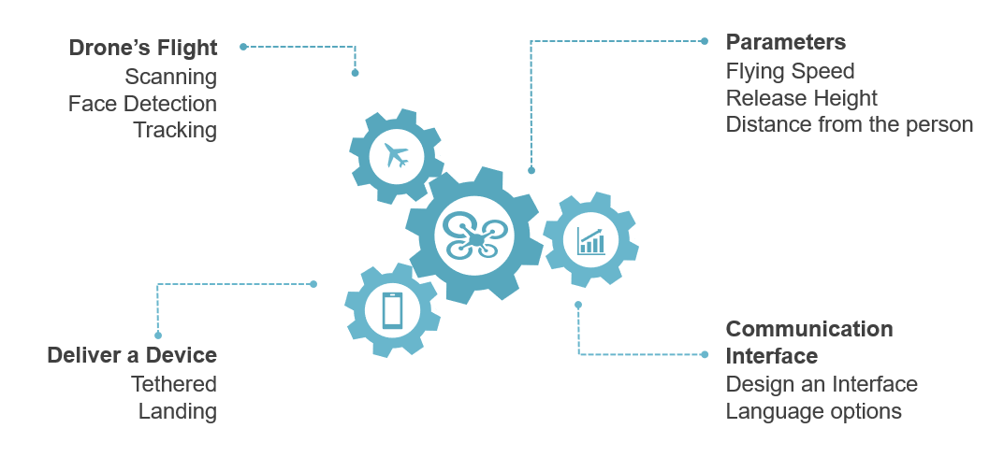
Limitations
Performing User Studies
You can simply impress your audience and add a unique zing and appeal to your Presentations. Easy to change colors, photos and Text.
Ordering Technical Parts
You can simply impress your audience and add a unique zing and appeal to your Presentations. Easy to change colors, photos and Text.

Slide 25
Summary
Human Drone Interaction
Develop an effective interaction
Drone Capabilities
Use the drone’s advantages in order to get better results
Information Gain
Add information for a better planning of the mission
SAR help
Can be extended for various uses

Slide 26
THANK YOU
FOR LISTENING

